Slide 1
Mali Africa RISING Program
Birhanu Zemadim
On behalf of ICRISAT and partners
Internal Project Evaluation Meeting
February 26-27, 2015
Sikasso

Slide 2
Partners:
Asian Vegetable Research and Development Centre (AVRDC)
Institute d’Economie Rurale (IER)
International Livestock Research Institute (ILRI)
International Centre for Agro-Forestry (ICRAF)
Afrique Verte (AMASSA)
Wageningen University and Research Centre (WUR)
Association Malienne d’Eveil et de Developpement Durable (AMEDD)
Cooperatives of the Mouvement Biologique du Mali (MOBIOM)
L’ong-Centre d’Appui a l’ Autopromotion pour le Development-ci-apresaenommee (L’ong-CAAD)
Le Groupe de Recherches d’Actions et d’Assistance pour le Development Communautaire (L’ONG-GRAADECOM)

Slide 3
Brief Introduction of
Africa RISING Project
in West Africa

Slide 4
The 5-year multi-disciplinary and multi-institutional research
Started in 2011
Sustainable Intensification of Crop-livestock mixed farming systems in the Guinea/Sudan Savanna Zone of West Africa
A farming systems approach which aims at integrating the key components of the production systems (e.g., crop, soil/water and livestock) with household nutrition and capacity building can raise and sustain household food and nutrition security and income

Slide 5
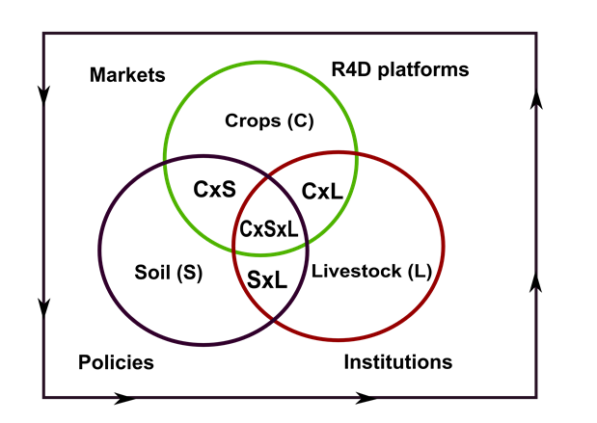
The ‘Africa RISING Project niche’
R4D on SI that considers the crops, soil, and livestock interactions within the socio-economic environment (markets, policies, institutions, and gender)

Slide 6
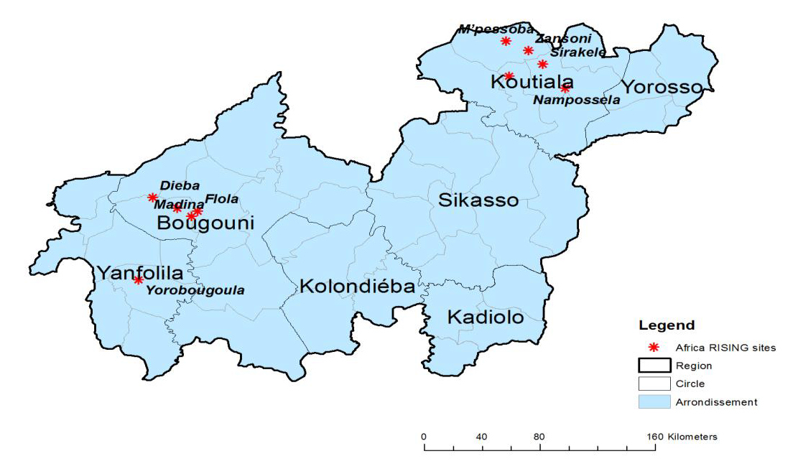
Implemented in 10 villages in Southern Mali.

Slide 7
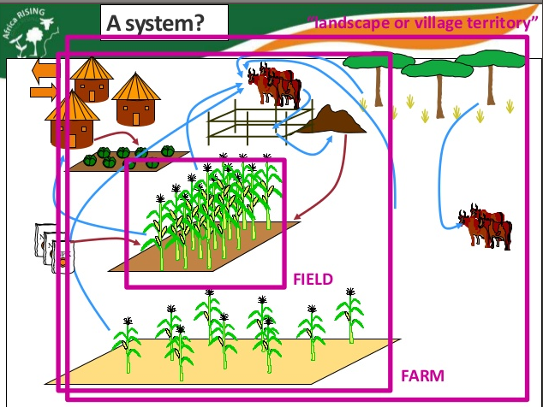
System Intensification Approach

Slide 8
Research Outputs
RO 1: Situation Analysis and Program-wide Synthesis
  Activities necessary to ensure that best bet or best-fit technological interventions address farmers’ priority constraints and to develop program-wide synthesis related to the lessons learnt
RO 2: Integrated Systems Improvement
  Broad approach of participatory technology identification, adaptation, and effective combination aiming to improve farming systems in terms of productivity, income, and natural resources management
RO3: Scaling and Delivery of Integrated Innovation
  Development of approaches for scaling-out systems innovations to similar development domains

Slide 9
Approach
Participatory technology development and/or identification
Training of Trainers workshops; Knowledge exchange and information flow among stakeholders
Implementing activities on-farm and on-station at the level of plot or field
Managing activities jointly (researchers & farmers)
Comparisons of on-farm activities with improved SI innovations and farmers’ practices
Demonstrate and scale-out new technologies and/or a combination of technologies
Graduate students involvement (On-station to develop, test, and adapt new technologies)

Slide 10
Activities defined in work packages
Work-package WP-1
Work-package WP-9
Work-package WP-5
Title: Socio-economic studies on sustainable intensification in the West African Guinea and Sudan Savanna
Title: Managing natural resources to increase watershed productivity
Title: Improving farm and field productivity and profitability in Mali
Village-level biomass and pasture assessment & mapping of grazing itineraries
Productivity of cereal-legume based crop and crop-livestock systems
Characterization of the R4D platforms
Farmer practices for cereal/legume-vegetable based systems
Documentation and validation of existing local conventions
R4DP stakeholder mapping
Establishing R4DP
Agro-forestry options for intensive fruit, vegetable and livestock fodder production
Participatory conflict management
Evaluation of the impact of R4DP on technology adoption and market participation
Monitor market prices and characterize value chains in Mali
Establishing and characterization of watershed area for integration of research activities
Market Analysis, economic & agronomic

Slide 11
Activities defined in work packages
Work-package WP-6
Work-package WP-10
Title: Intensifying livestock and poultry production in Ghana and Mali
Title: Improving household nutrition through agricultural and behavioral change communication and value addition in Ghana and Mali
Activity 2: Plan and perform trials on integrated intensification options for livestock feeding in Mali
Activity 6: Review and document nutrition activities in Mali

Slide 12
Options for scaling-out and scaling-up
Establishment of R4D platforms
Use of GIS tools and Remote Sensing techniques, modeling to scale-out workable technologies to broader areas
Support to community seed production to enhance adoption
A sustainable supply of seeds and planting materials for locally appropriate varieties and species
The development of enterprises for production and distribution of livestock breeding stock and breeds for diversification and intensification of the production systems

Slide 13
Plans for integration of activities
Developing set of multiple tools at various scales of operation
Working in common area (technology parks, watershed, landscape?)
R4D Platform (commune level) and IPs (local level)
Planning meetings to have joint planning; joint contracts
Annual program events; results and feedbacks and follow-ups

Slide 14
Challenges Encountered
Management Level
Change of Mali activity coordinator (the present coordinator took in charge in March 2014)
Difficulties to pre-finance the committed activities even though partners are sure of getting the 700K committed from IITA
Amending contracts to start activities take four to six months (One time fund release is a possibility to avoid such issue)
There are no specific plans for monitoring and evaluation (M&E) at activity level (Number of targeted beneficiaries were not set)

Slide 15
Activity Level: Farmers and Researchers
Getting field trial protocols in local language (Bambara or in Mianka)
  Risk of losing appropriate procedures for trial establishments
Lack of incentive systems (project fatigue)
Villagers are becoming urbanized (e.g M’Pessoba and Yorobougoula)
  Creating difficulties in mobilizing farmers for crop trial establishments and natural resources management
Late start of activities
  Lack of enough farm space for crop trial establishments
  Early sawing of crops by farmers hence difficulties to make trial comparisons with farmers practice
Committed portion of farmers’ land by women participants may not get approval by the head of the house (male headed)
  Undermines planned activities in the case of crop trails

Slide 16
Little understanding and uptake by farmers to adapt improved land and water management
  Out of 32 farmers who were trained and promised to implement land and water mgt. 66% implemented the technology in their farm fields
  Out of 21 farmers who implemented CBT in their farm fields 7 (33%) planted appropriate grass (Andropogon) to keep the bund stable and reduce erosion
Challenges in human resources and marketing made the feeding trials challenging for ICRISAT to continue.
  ICRISAT has in-house expert (crop-livestock)
  Coordination of field/production activities not always easy
    In particular to nutrition component of the program

Slide 17
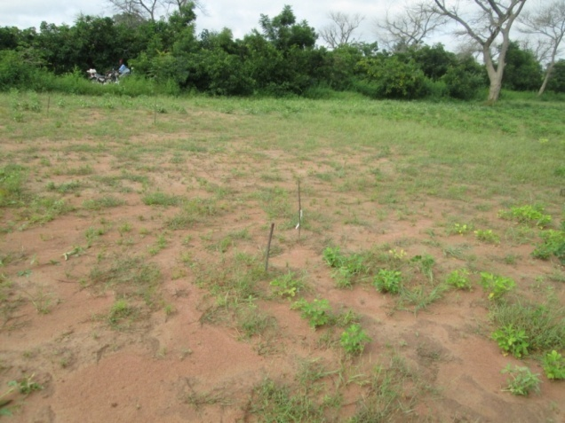
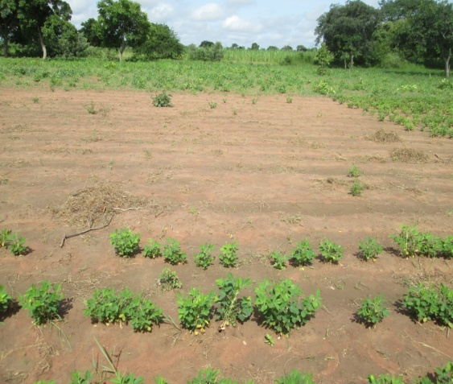
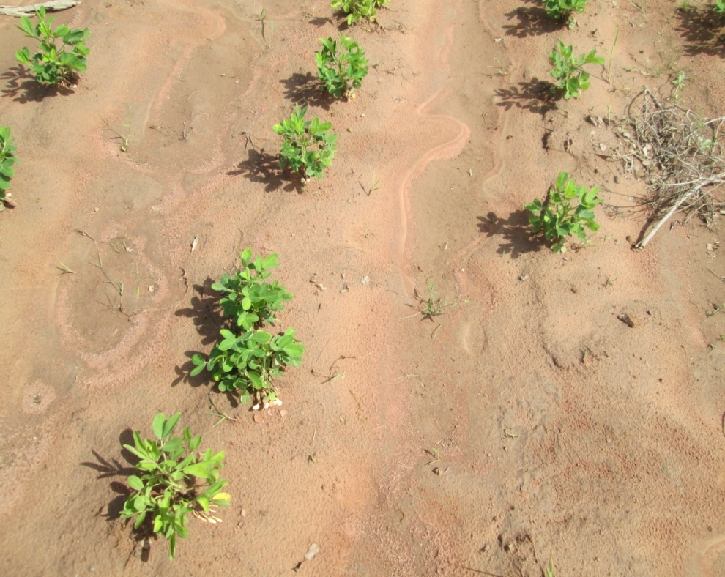
Challenges cntd..
Un-established/un-germinated groundnut seed variety (ISGV03056, seed provided by ICRISAT) in farmer trail fields
  Possible cause, seed is too old/not properly conserved
Problem of Erosion and flooding
  Exposing seed formations
  One rainfall event is enough to wash the farmland
Erratic rainfall mainly affecting establishment of veg. trails (Breeders need to develop varieties that are drought tolerant)
FFS Trial with AMASSA
Famer practice
Groundnut establishment affected by erosion in Farmers field in M’Pessoba

Slide 18
Other challenges: Institutional
Financial: Partners are not sending liquidation statements in time. AMASSA done it in time
Technical: Need to be concise. Support is needed by scientists
Data: Sharing need to be done: we should break the constraint
Platforms for communication: Not everyone is skilled in use of platforms like wiki, yammer, etc…

Slide 19
Our Strength
Effective planning and activity implementation
Partnership(CG, NGOs, communities)
Conducting demand driven research for development
Synergizing projects, complementarity (Dry land System, WLE, McKnight Foundation, ARDT, USAID GCC, FARMSEM)

Slide 20
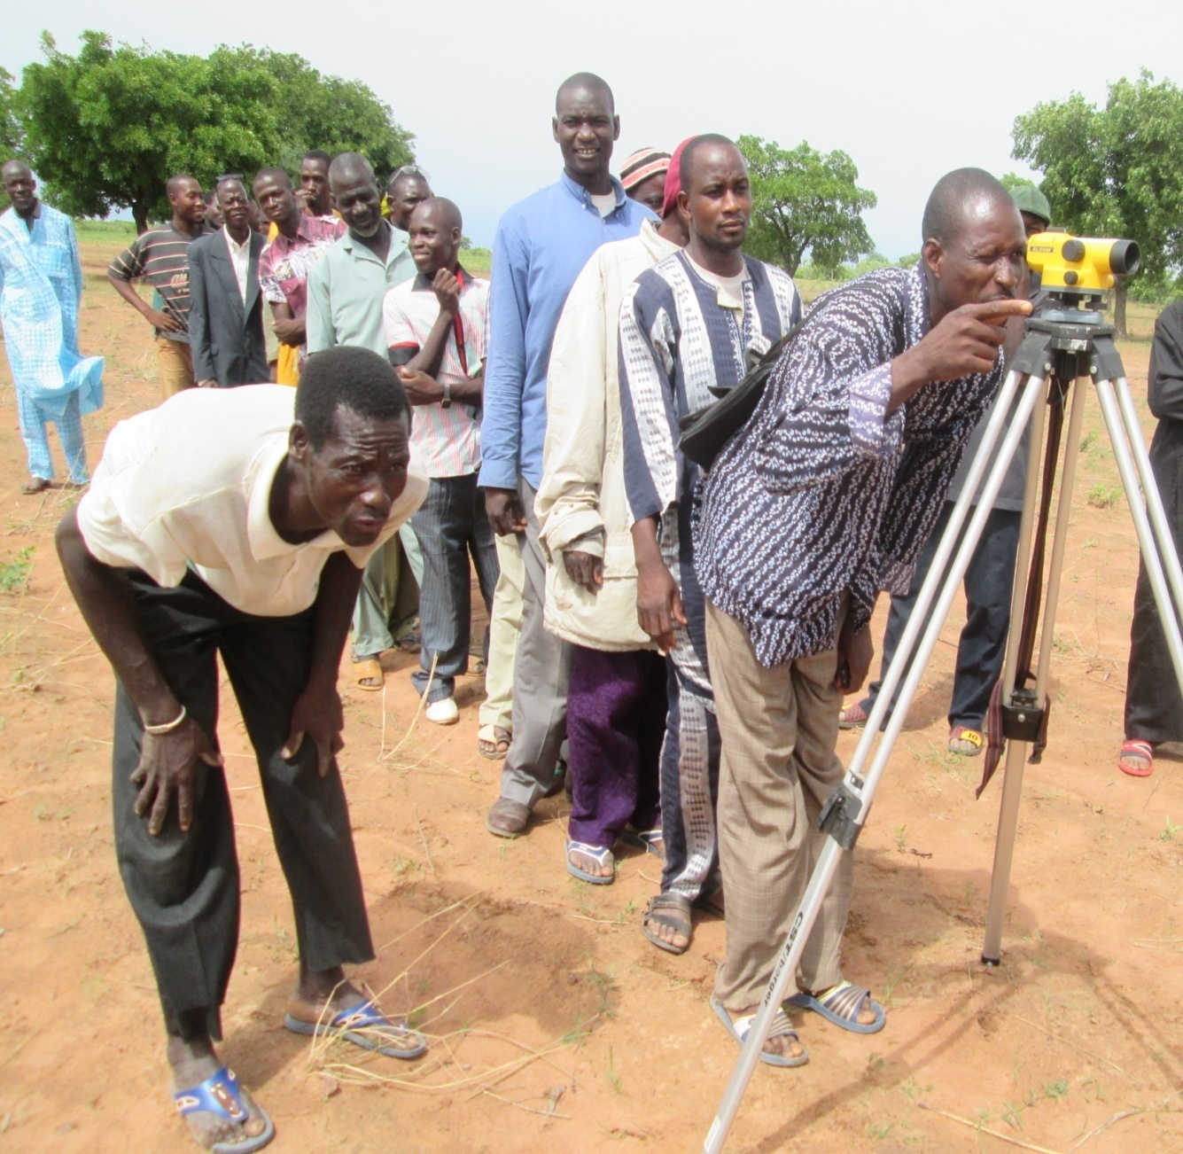
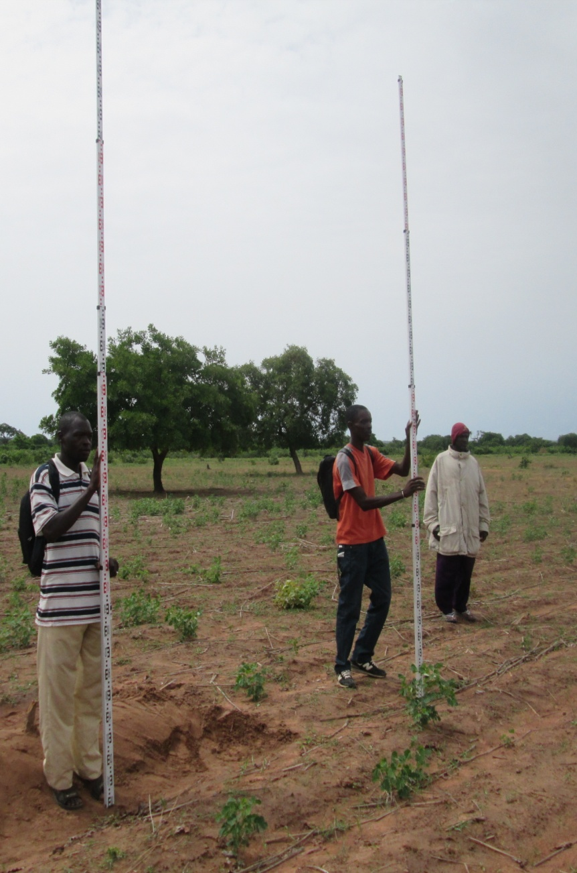
Thank you!

Slide 21
Mali Africa RISING 2014 Activities
Activity briefing provided by participating scientists and partners

Slide 22
Planned Activities for 2014
Work-Package 1 Dr. Joachim
Title: Socio-economic studies on sustainable intensification in the West African Guinea and Sudan Savanna
Institutes: ICRAF (Lead), AMEDD and ICRISAT
Activity 2: Establishment and characterization of R4D Platforms
in Mali
2.1: Characterization of R4D Platform sites (Bougouni and Koutiala/Yanfolila districts):
2.2: Quick assessment of relevant stakeholders
2.3: Stakeholder analysis and mapping
2.4: Multi-stakeholder national workshop for feedback on results of the different work packages
2.5: Establish and assess impact of R4D Platforms on technology adoption

Slide 23
Cntd..Planned Activities for 2014
Activity 4 Monitor market prices and characterize value chains in Mali Dr. Sanogo
Institutes IER
4.1: Monthly monitoring of prices of agricultural products in three large, weekly markets in Koutiala and Bougouni
4.2: Annual monitoring of basic farming household characteristics in Africa RISING villages
4.3: Value chain studies on at least three value chains identified by the R4D platforms

Slide 24
Cntd..Planned Activities for 2014
Work-package WP-5 Dr. Albert
Title: Improving farm and field productivity and profitability in Mali
Institutes: ICRISAT, ICRAF, AVRDC, AMEDD and WUR
Activity 1: Develop profitable and sustainable options to intensify productivity of cereal-legume based crop and crop- livestock systems
1.1: Analyze and report data from cereal-legume-vegetable experiments conducted in 2012 and 2013
1.2: Organize feedback sessions with stakeholders
1.3: Plan and perform trials on integrated intensification options for cereals and legumes

Slide 25
Cntd..Planned Activities for 2014
Activity 2: Determine farmer practices for cereal/legume- vegetable based systems, test integrated innovations and assess productivity and profitability Mary
2.1: Assess productivity and profitability of integrated innovations for cereal/legume-vegetable cropping systems and identify opportunities for scaling
2.2: Test and disseminate promising technologies to intensify vegetable mono-cropping in cereal-based crop systems in off-season

Slide 26
Cntd..Planned Activities for 2014
Activity 3: Develop agroforestry options for intensive fruit, vegetable and livestock fodder production Dr. Catherine
3.1: Monitor fruit tree establishment trials established in 2013 for intensive fruit production
3.2: Intensive leafy vegetable production from Adansonia digitata (baobab) and Moringa oleifera
3.3: Improving soil fertility using fodder and fertilizer tree species

Slide 27
Cntd..Planned Activities for 2014
Activity 4: Estimating efficiency of farm system components and whole farms (economic and agronomic) Mary
4.1: Define and propose a framework for data sharing between Africa RISING partners and Wageningen University
4.2: Parameterize component and whole farm system models and determine trade-offs:

Slide 28
Cntd..Planned Activities for 2014
Work-package WP-6
Title: Intensifying livestock and poultry production in Ghana and Mali Mary
Activity 2: Plan and perform trials on integrated intensification options for livestock feeding in Mali

Slide 29
Cntd..Planned Activities for 2014
Work-package WP-9 Dr. Birhanu, Clarisse and Mary
Title: Managing natural resources to increase watershed productivity in southern Mali
Institutes: ICRISAT, ILRI, WUR and AMEDD
Activity 1: Village-level biomass and pasture assessment and mapping of grazing itineraries. Mary
1.1: Village-level biomass and pasture assessment and mapping of grazing itineraries
1.2: Mapping of grazing itineraries

Slide 30
Cntd..Planned Activities for 2014
Activity 2: Documentation and validation of existing local conventions Clarisse
2.1: Documentation of existing local conventions
2.2: Validation workshops on local conventions
Activity 3: Participatory conflict management Clarisse
3.1: Workshops on conflict management
3.2: Participatory conflict analysis and management
3.3: Documentation of transhumance practices

Slide 31
Cntd..Planned Activities for 2014
Activity 4 Establishing and characterization of watershed area for integration of research activities Birhanu
4.1: Establish and characterize a watershed area for integrated research
4.2: Farmers training on contour bund technology (CBTs)
4.3: Experimentation on appropriate land and water management technologies
4.4: Modeling from field to watershed level using biophysical model
Activity 5 Integrated modeling of intensification and land use at village level Mary

Slide 32
Cntd..Planned Activities for 2014
Work-package WP-10 Dr. Eva/Dr. Caroline
Title: Improving household nutrition through agricultural and behavioral change communication and value addition in Ghana and Mali
Institutes: ICRAF, ICRISAT, AVRDC, AMEDD
Activity 6: Review and document nutrition activities in Mali
6.1: Review and confirm nutrition training modules with input from nutritionists
6.2: Participatory evaluation of the nutrition field schools
6.3: Joint Ghana-Mali nutrition planning to develop 2015 work plans

Slide 33
Thank you!

Slide 34
Biophysical Characterization of Africa RISING Villages

Slide 35
Climate: 30 year data from Koutiala station
Mean daily climatic values
Rainfall 2.3mm
Maximum temperature 34ᵒC
Minimum temperature 22ᵒC
Wind speed 2.3m/s
Relative humidity 31%
Solar radiation 20.2 MJ/m²
Long term data 1980-2010
Historical maximum rainfall 97mm (recorded on 02/08/1998)

Slide 36
Rainfall: 30 year data from Koutiala station

Slide 38
Water and soil fertility management
Birhanu et al.,2014

Slide 39
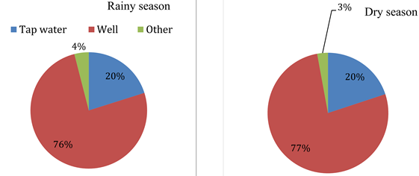
Shallow Ground Water Wells
Commonly used water source during rainy and dry seasons
Birhanu et al.,2014

Slide 40
I
Well Inventory, geo-referencing and analysis
Bougouni: 150 Wells
  All wells in Dieba, Floala, Madina and Sibirila
  30% of wells in Yorobougoula
Koutiala: 335 Wells
  All wells in Nampossela and Sirakele
  Zanzoni (50%), Ngolonianasso (70%), M’Pessoba (30%)

Slide 41
Parameters used to characterize shallow wells
  Year and depth of construction
  Diameter of the well
  Depth of water in the well during dry and rainy seasons
  Use of the well
  Number of households using the well

Slide 42
Well construction History
Bougouni
Koutiala
Nampossela village: maximum number of well constructed
First Well constructed in Zanzoni communal well
Sibirila village: maximum number of well constructed
First well constructed in Madina (1954)

Slide 43
Depth of Well construction
Koutiala
Bougouni
Minimum depth in Yorobougoula 2.5m
Maximum depth in Sibirila 34.5m and Nampossela 150m
Majority are within the depth range of 6.5 to 10.5m
Bougouni well diameter range: 1.0-8.5m (1-1.2m make 33% of total)
Koutiala well diameter range: 0.9-2m (1-1.2m make 41% of total)

Slide 45
Use of shallow well
Most wells in Bougouni are for domestic purpose
In Yorobougoula 97% of wells are used for domestic and livestock water need.
More livestock in Yorobougoula?
Most wells in Koutiala are for household and livestock purpose
In M’pessoba 97% of wells are used for domestic purpose
Less livestock in M’pessoba?

Slide 46
Shallow well users: Household disaggregated
Village | Percentage of Wells HH Bougouni Data
 | 1HH | 2HH | 3HH | 4HH | 5HH | 6HH | 7HH | 8HH | 9HH | 10HH | >10HH
Dieba | 0% | 11% | 19% | 22% | 28% | 6% | 6% | 0% | 3% | 3% | 3%
Flola | 8% | 8% | 33% | 25% | 17% | 0% | 8% | 0% | 0% | 0% | 0%
Sibirila | 0% | 17% | 8% | 0% | 42% | 0% | 8% | 0% | 0% | 8% | 17%
Yorobougoula | 17% | 10% | 16% | 14% | 12% | 10% | 0% | 3% | 0% | 14% | 3%
Madina | 10% | 10% | 17% | 17% | 28% | 0% | 3% | 0% | 0% | 7% | 7%
Average | 7% | 11% | 19% | 16% | 25% | 3% | 5% | 1% | 1% | 6% | 6%
Village | Percentage of Wells HH Koutiala Data
 | 1HH | 2HH | 3HH | 4HH | 5HH | 6HH | 7HH | 8HH | 9HH | 10HH | >10HH
Zanzoni | 35% | 16% | 27% | 4% | 6% | 2% | 1% | 2% | 0% | 4% | 4%
Nampossela | 15% | 9% | 15% | 3% | 24% | 12% | 3% | 0% | 0% | 9% | 9%
Ngolonianasso | 25% | 35% | 23% | 6% | 6% | 1% | 1% | 0% | 0% | 0% | 1%
Sirakele | 16% | 0% | 14% | 8% | 16% | 2% | 6% | 0% | 0% | 28% | 10%
M'pessoba | 28% | 13% | 21% | 9% | 15% | 3% | 2% | 0% | 0% | 7% | 2%
Average | 24% | 15% | 20% | 6% | 13% | 4% | 3% | 0% | 0% | 10% | 5%

Slide 47
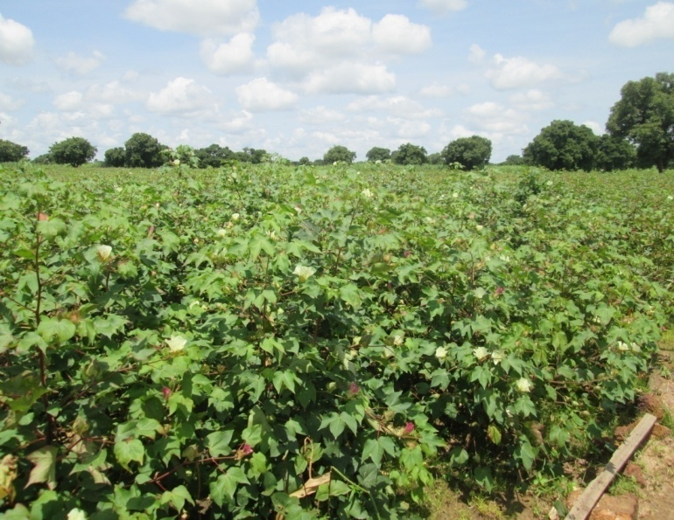
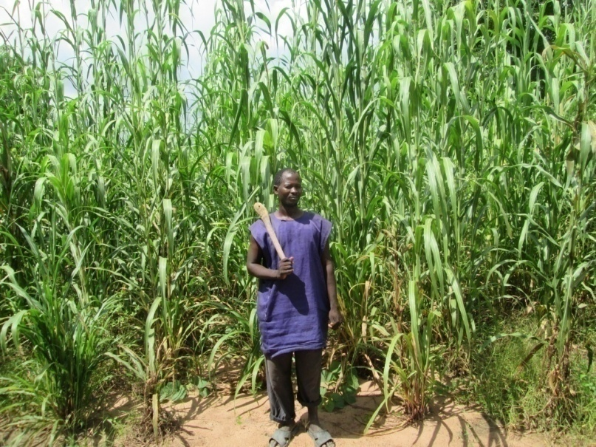
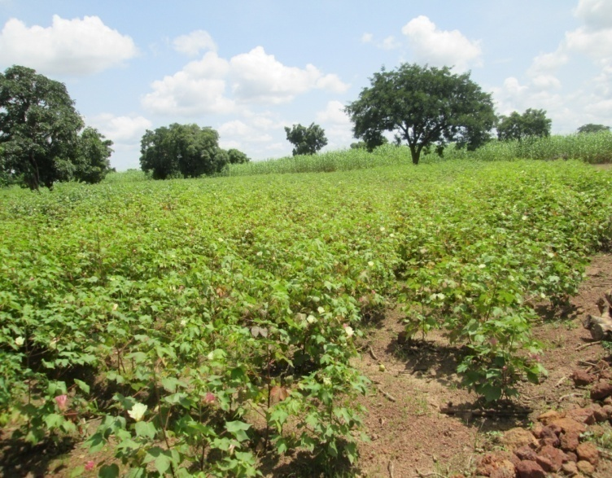
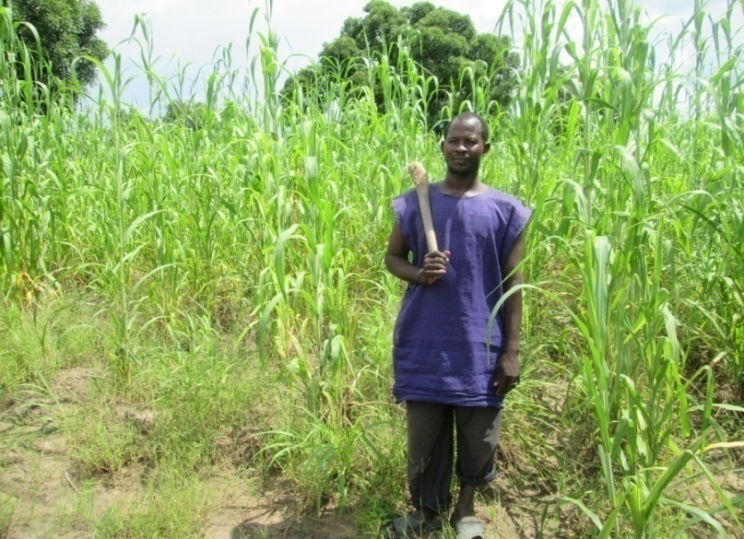
Experimentation…………..
Improving management of farmers’ field
With constructed
bund
Without bund

Slide 48
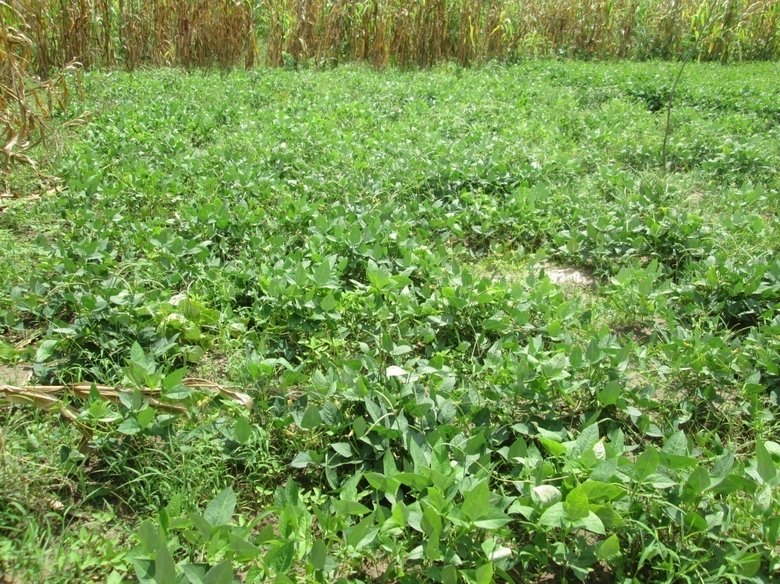
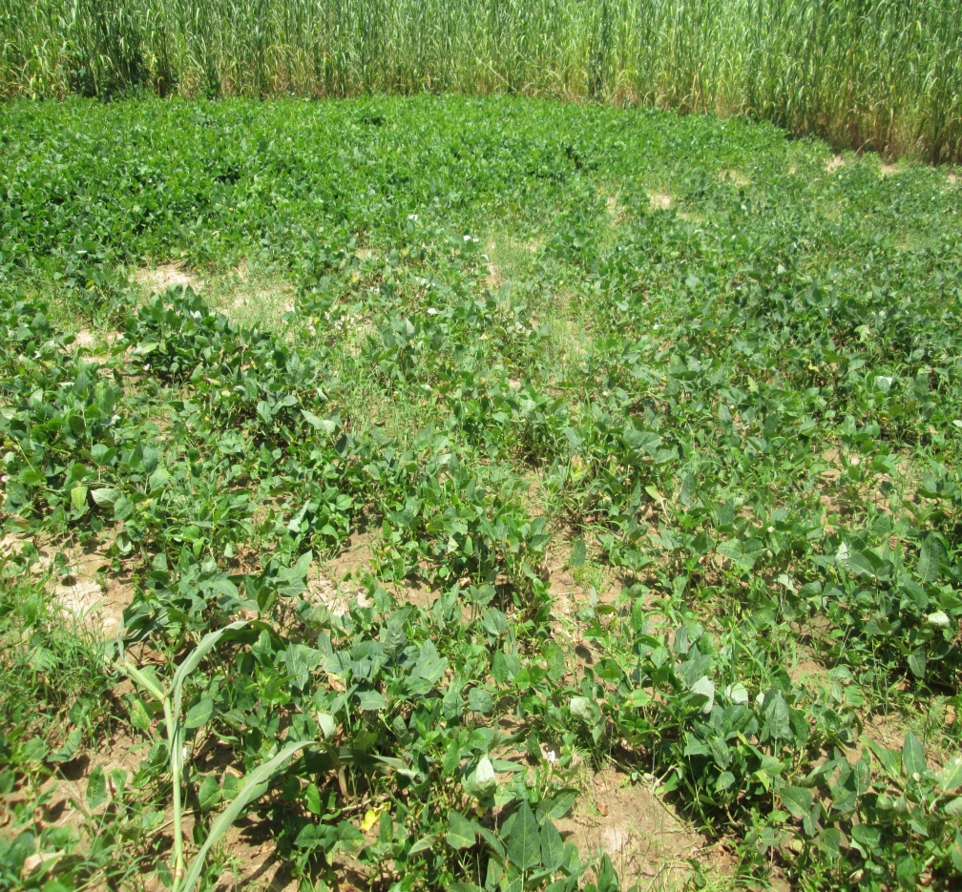
Field Crop Experimentation
Cowpea
With constructed bund in Try village
Without constructed bund in Kani village

Slide 49
Thank you!

